Slide 1



IDEATE.BLR / 26 — AN AI IDEATHON
01 / 09
IDEATE
TEAM_SUBMISSION
TEAM NAME
Confidex
BLR ʼ26
TRACK
IDEATE
|
INNOVATE
|
IMPACT
Open Innovation with AI
INSTITUTION
Vijaya Vittala Institution of Technology
SEP 3
REVA UNIVERSITY
THURSDAY
BENGALURU
Notes:
Open with team name and the track you chose. Ten seconds, no more.
1

Slide 2

01 / TRACK & PROBLEM
02 / 09
THE PROBLEM
TRACK CHOSEN
PROBLEM STATEMENT
Open Innovation with AI
The Hidden Risk Behind Authorized Access
WHY THIS TRACK
Authorized employees can move confidential data to USBs, personal cloud, or external destinations, while traditional logs show what happened—not whether the action is actually risky.
AI can turn millions of raw security events into contextual, prioritized risks—helping security teams identify dangerous data movement faster.
IDEATE BLR ʼ26 — AI IDEATHON
REVA UNIVERSITY / BENGALURU
Notes:
Name the track, then state the problem in one sentence before the detail.
2

Slide 3
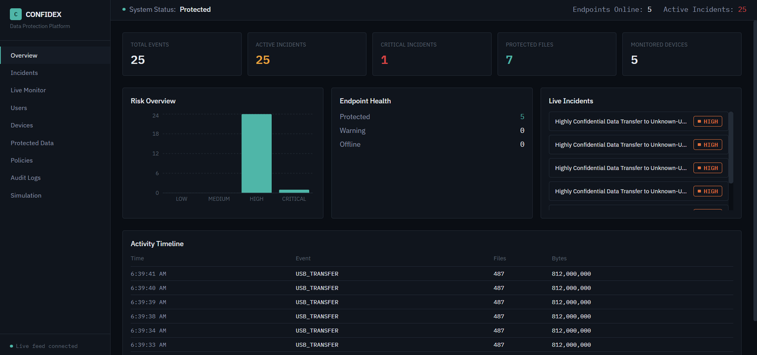
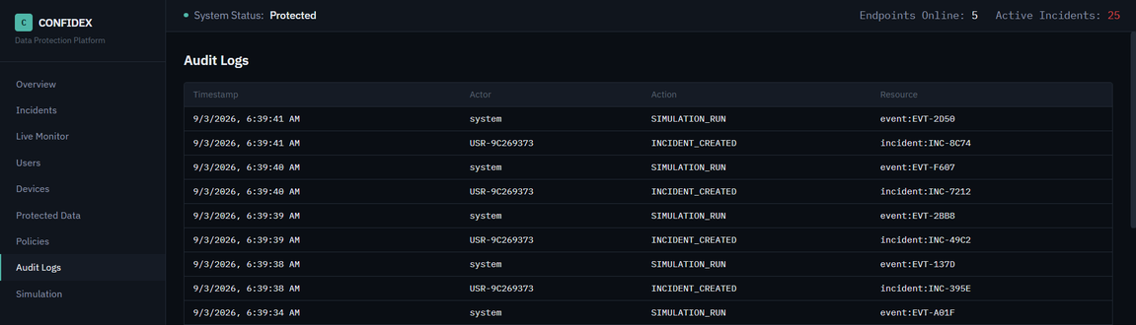
02 / THE IDEA
03 / 09
THE IDEA
VALUE PROPOSITION
CONFIDEX transforms raw data-movement events into contextual risk intelligence—detecting, prioritizing, and alerting on confidential-data exfiltration in real time.
DROP VISUAL HERE
1
UNDERSTAND CONTEXT
Know who, what, where, and how sensitive data is moving.
2
PRIORITIZE RISK
Convert events into an explainable 0–100 risk score.
3
ACT IN REAL TIME
Create incidents and alert security managers instantly.
Notes:
Lead with the one-line value proposition, then walk the visual.
3

Slide 4
03 / ARCHITECTURE
04 / 09
HOW IT WORKS
CONFIDEX DATA FLOW
01
02
03
04
05
INPUT
AI PROCESSING
INTELLIGENCE
DECISION
IMPACT
Real-Time Alert
Manager Notification
Investigation Dashboard
Data Movement Event
File copied /
USB /
Cloud /
External
destination
User
File
Device
Destination
Behaviour
Policy
Evaluation
Behavior
Analysis
Risk Scoring
Risk: 0–100
Low
Medium
High
Critical
Incident Created
IDEATE BLR ʼ26 — AI IDEATHON
REVA UNIVERSITY / BENGALURU
Notes:
Five modules, one breath each. Do not read the boxes aloud.
4

Slide 5
04 / THE STACK
05 / 09
THE TECHNOLOGY
AI / ML
FRONTEND
BACKEND
  Context Engine
  Policy Engine
  Risk Scoring
  Behavioral Analysis
  Next.js
  React
  TypeScript
  Tailwind CSS
  FastAPI
  Python
  Pydantic
  SQLAlchemy
DATABASE
CLOUD
APIS
  PostgreSQL
  Users & Devices
  Events & Incidents
  Policies & Audit Logs
  WebSockets
  Live Event Streaming
  Instant Alerts
  Docker Compose
  .env Configuration
  Local / Enterprise Ready
IDEATE BLR ʼ26 — AI IDEATHON
REVA UNIVERSITY / BENGALURU
Notes:
Name the stack, do not defend it. Judges ask if they care.
5

Slide 6
05 / IMPACT
06 / 09
FROM IDEA TO IMPACT
94/100
100%
WHO IT SERVES
10X
Target Users: Enterprise SOC Teams, Chief Information Security Officers (CISOs), Security Analysts, and Compliance Officers.
What Changes: Shifts cybersecurity defense from reactive log searching to proactive, context-driven exfiltration prevention.
CRITICAL RISK DETECTED
Identifies high-risk confidential data transfers through contextual risk scoring.
REAL-TIME ALERTING
Continuous streaming pipeline detects unauthorized file copies in seconds.
FASTER SOC RESPONSE
Eliminates noise and false positives, accelerating analyst investigations.
IDEATE BLR ʼ26 — AI IDEATHON
REVA UNIVERSITY / BENGALURU
Notes:
Three numbers. Say where each one comes from.
6

Slide 7
06 / DIFFERENTIATION
07 / 09
MODULE_06
CRITERION
EXISTING SOLUTIONS
OUR SOLUTION
DETECTION
Detects file/device activity
Detects suspicious data movement
CONTEXT
Mostly event-based logs
Understands user + file + destination + behavior
RISK
Rule/alert driven
Contextual 0–100 risk scoring
RESPONSE
Generates alerts/logs
Creates incidents + alerts the right authority
IDEATE BLR ʼ26 — AI IDEATHON
REVA UNIVERSITY / BENGALURU
Notes:
Pick the two rows that matter most. Skip the rest.
7

Slide 8
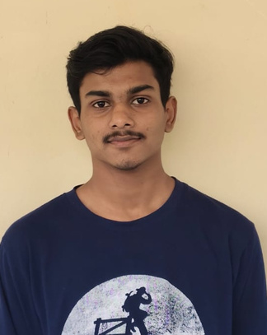


07 / TEAM
08 / 09
TEAM NAME
Confidex
THE TEAM
01
02
03
NAME
NAME
NAME
Daniel Richard Xavier E
Dhikshitha A
Harish P
EMAIL
EMAIL
EMAIL
drx2021@gmail.com
dhikshitha307@gmail.com
harishhari781823@gmail.com
MOBILE
MOBILE
MOBILE
9380987187
7892563979
9901709596
Notes:
Names and one contact. Do not read every phone number aloud.
8

Slide 9
08 / REFERENCES
09 / 09
REFERENCES
SOURCES / 2026
1
Microsoft Learn, Learn about Data Loss Prevention (DLP), 2026.
5
MITRE ATT&CK, Detection of USB-Based Data Exfiltration
2
Microsoft Learn, Microsoft Purview Data Security Solutions, 2026
6
Microsoft Learn, Data Loss Prevention Analytics, 2026.
3
CISA, Insider Threat Mitigation Guide, 2026.
7
CISA, Insider Threat Mitigation Resources and Tools
4
MITRE ATT&CK, Exfiltration Over Physical Medium
8
MITRE ATT&CK, Detection of Data Exfiltration via Removable Media
Notes:
Leave this up while judges ask questions.
9

Slide 10
Thank
you!

